Slide 1
FLIGHT FARE PREDICTION
Amritesh Kumar
Dec 2021

Slide 2
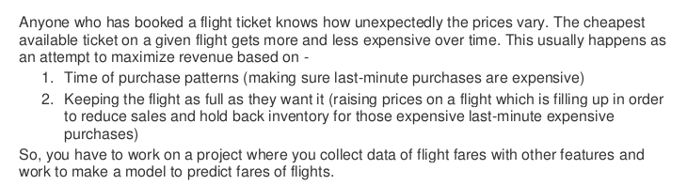
ABSTRACT
1

Slide 3
EXPERIMENTAL SET UP
Hardware requirements:-
1. Processor — core i5 and above
2. RAM — 8 GB or above
3. SSD— 250 GB or above
Software requirements:-
1. ANACONDA
1

Slide 4
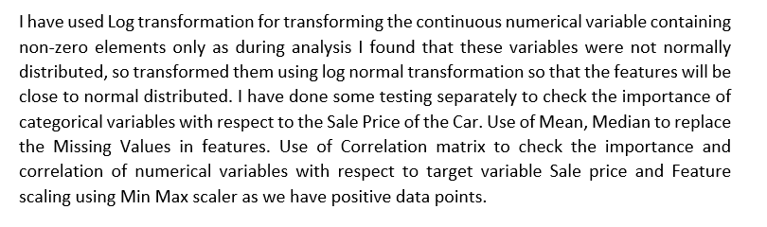
INTRODUCTION
1

Slide 5
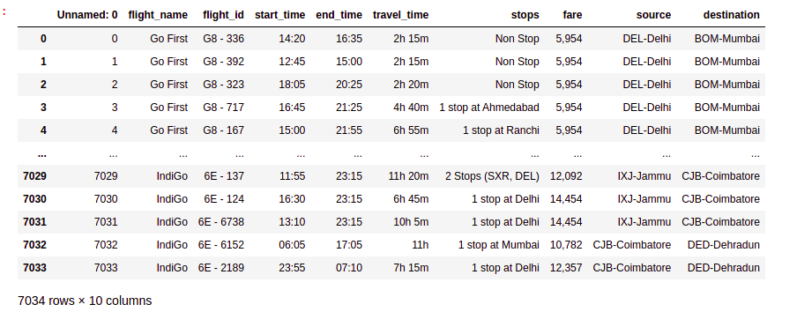
DATA PREPRATION
With the help of Pandas Library, We will upload our data to Jupyter Notebook.
Once our data is uploaded with the help of predefined method (i.e. read_csv) we can read data for further processing.
We have two type of variables in the data:-
Dependent Variable
Independent Variable
<number>

Slide 6

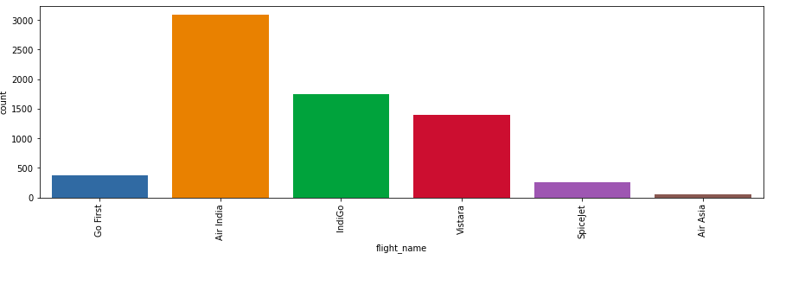
<number>

Slide 7
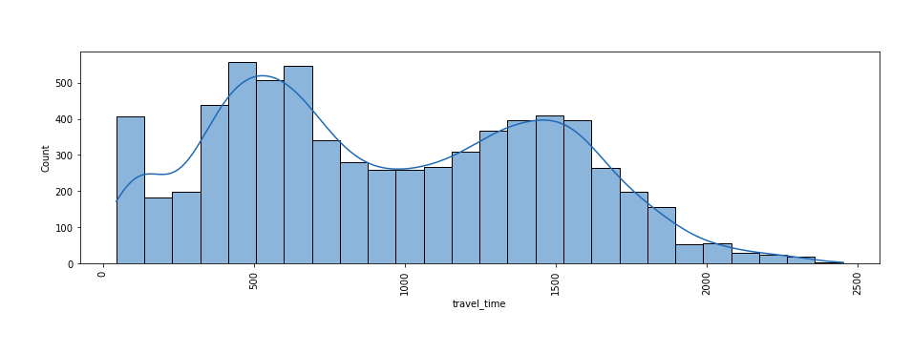

Slide 8
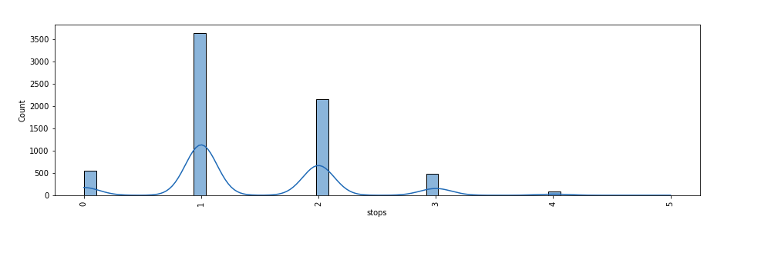

Slide 9
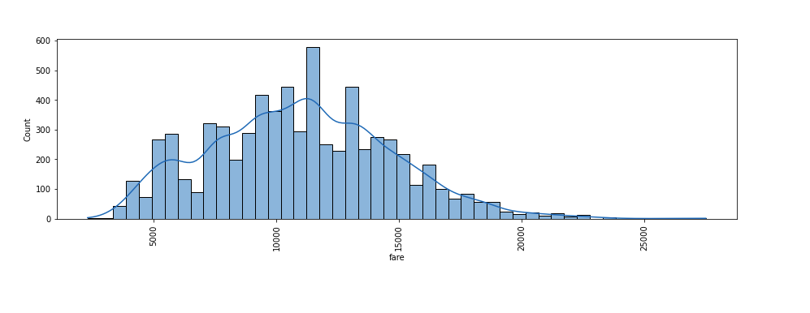

Slide 10
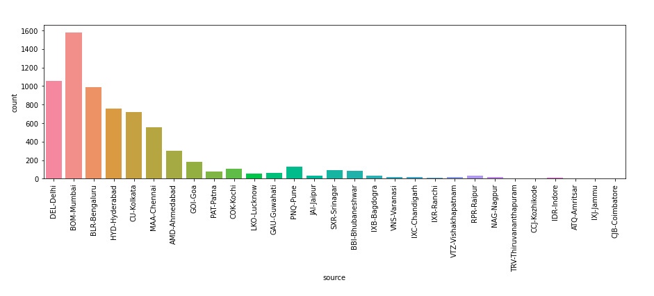

Slide 11
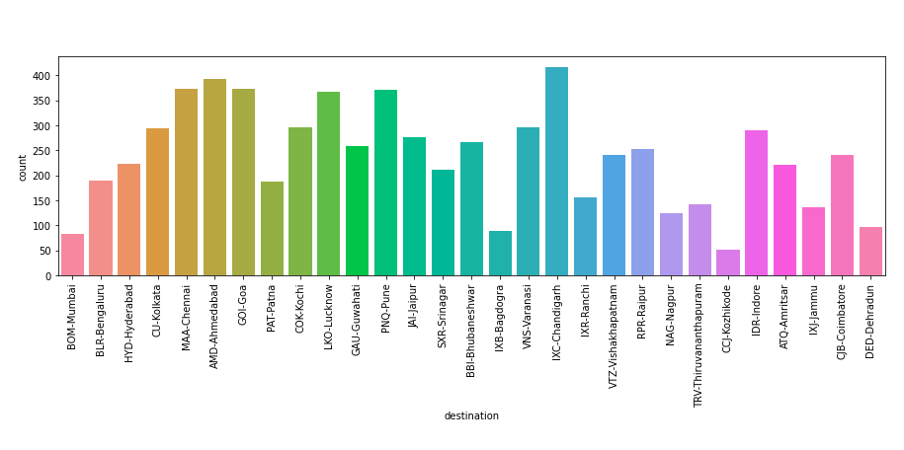

Slide 12
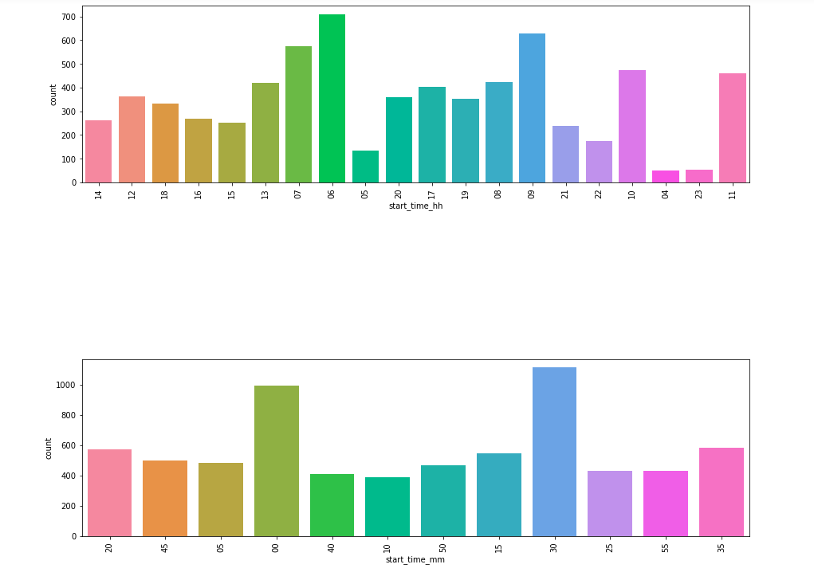

Slide 13
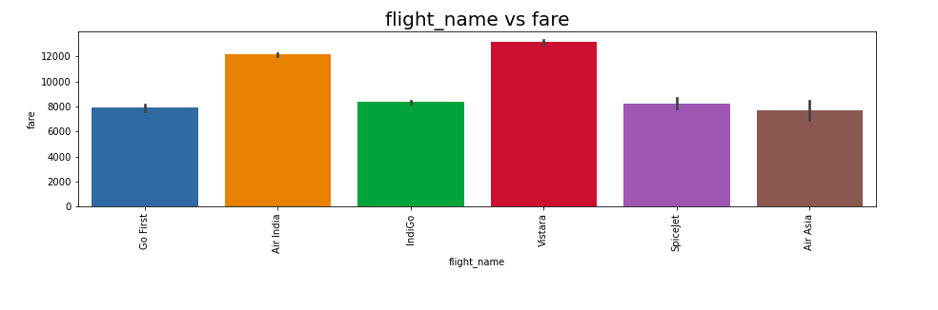

Slide 14
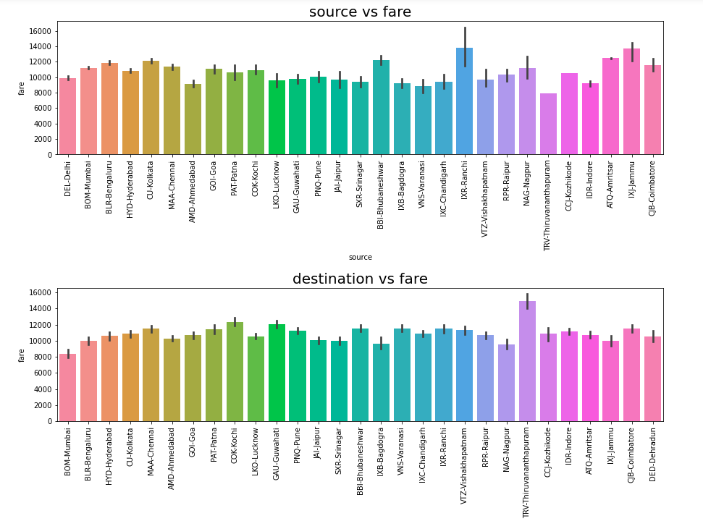

Slide 15
DATA PRE-PROCESSING
The Complete data is divided in the ration of 67:33 for train and test respectively.
There is lots of null values present in the data-set and there are some outliers present in the data=set which has been replace with padding and not available .
Once our data is ready categorical variables are converted into the numeric form, which we can apply further on algorithms.
I have dropped the some column since there is no correlation between output variable and with those columns.
<number>

Slide 16
EVALUTION PROCESS
R2 Score:
Adjusted R2 Score deals with additional independent variables.
This R squared value of the r-square if our choice of independent variable wasn’t good (i.e. independent variable had no effect on dependent variable)
Also the bias of R Square to not decrease is handled pretty well in this adjusted R Squared method.
Cross Validations:
K Fold cross validations , K = 5
<number>

Slide 17
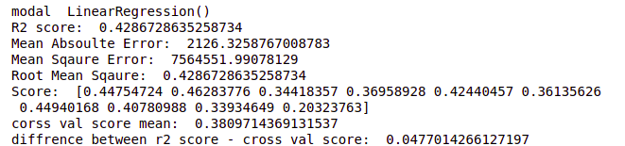
Linear Regression
<number>

Slide 18
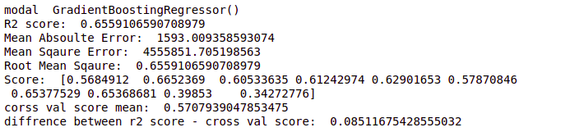
Gradient Boosting Regressor
<number>

Slide 19
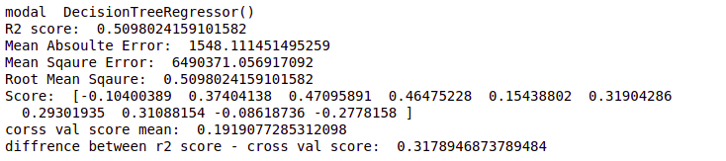
Decision Tree Regressor
<number>

Slide 20
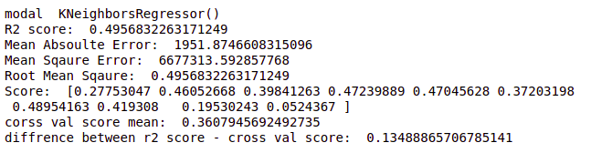
K Neighbors Regressor
<number>

Slide 21
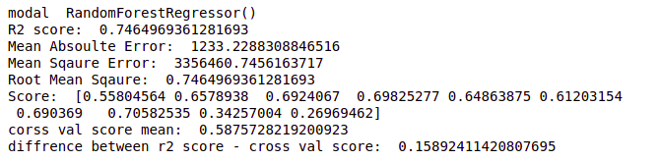
Random Forest Regressor
<number>

Slide 22
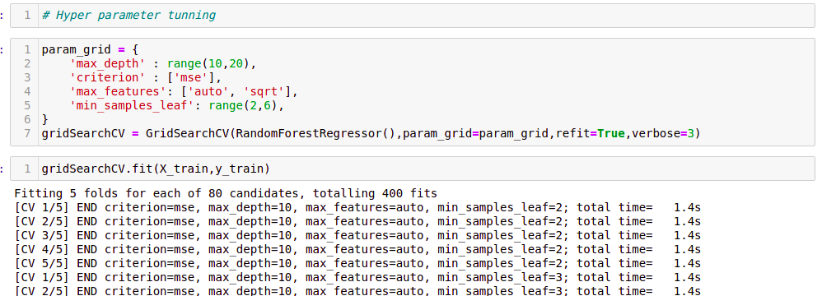
RESULT
From the details on the above solutions it is clearly understandable that we are getting best result with the help of Random Forest Regression so we save this model with the help of joblib Library.
<number>

Slide 23
CONCLUSION
From this dataset I get to know that each feature plays a very import role to understand the data. Data format plays a very important role in the visualization and Appling the models and algorithm
The power of visualization is helpful for the understanding of data into the graphical representation its help me to understand that what data is trying to say, Data cleaning is one of the most important steps to remove missing value or null value fill it by mean median or by mode or by 0.
Various algorithms I used in this dataset and to get out best result and save that model. The best algorithm is Random Forest Regressor.
<number>

Slide 24
FUTURE WORK
Limitations of this project is we have less number of features. If we get interior column, where we will get feature like, Food servied in flihgt etc. More the number of features, more accuracy we’ll get.
In future, if someone do the proper and detail study of this dataset’s each column than the accuracy will be so high.
<number>

Slide 25
Thank You

